Slide 1

2024 and Beyond: Ag Tax Update and the Corporate Transparency Act
11th Annual Mid-South Agricultural & Environmental Law conference
June 7, 2024

Slide 2

Contact Information
Kristine Tidgren
Director and Adjunct Associate Professor
ISU Center for Agricultural Law and Taxation
Agricultural Education and Studies
ktidgren@iastate.edu
www.calt.iastate.edu

Slide 3
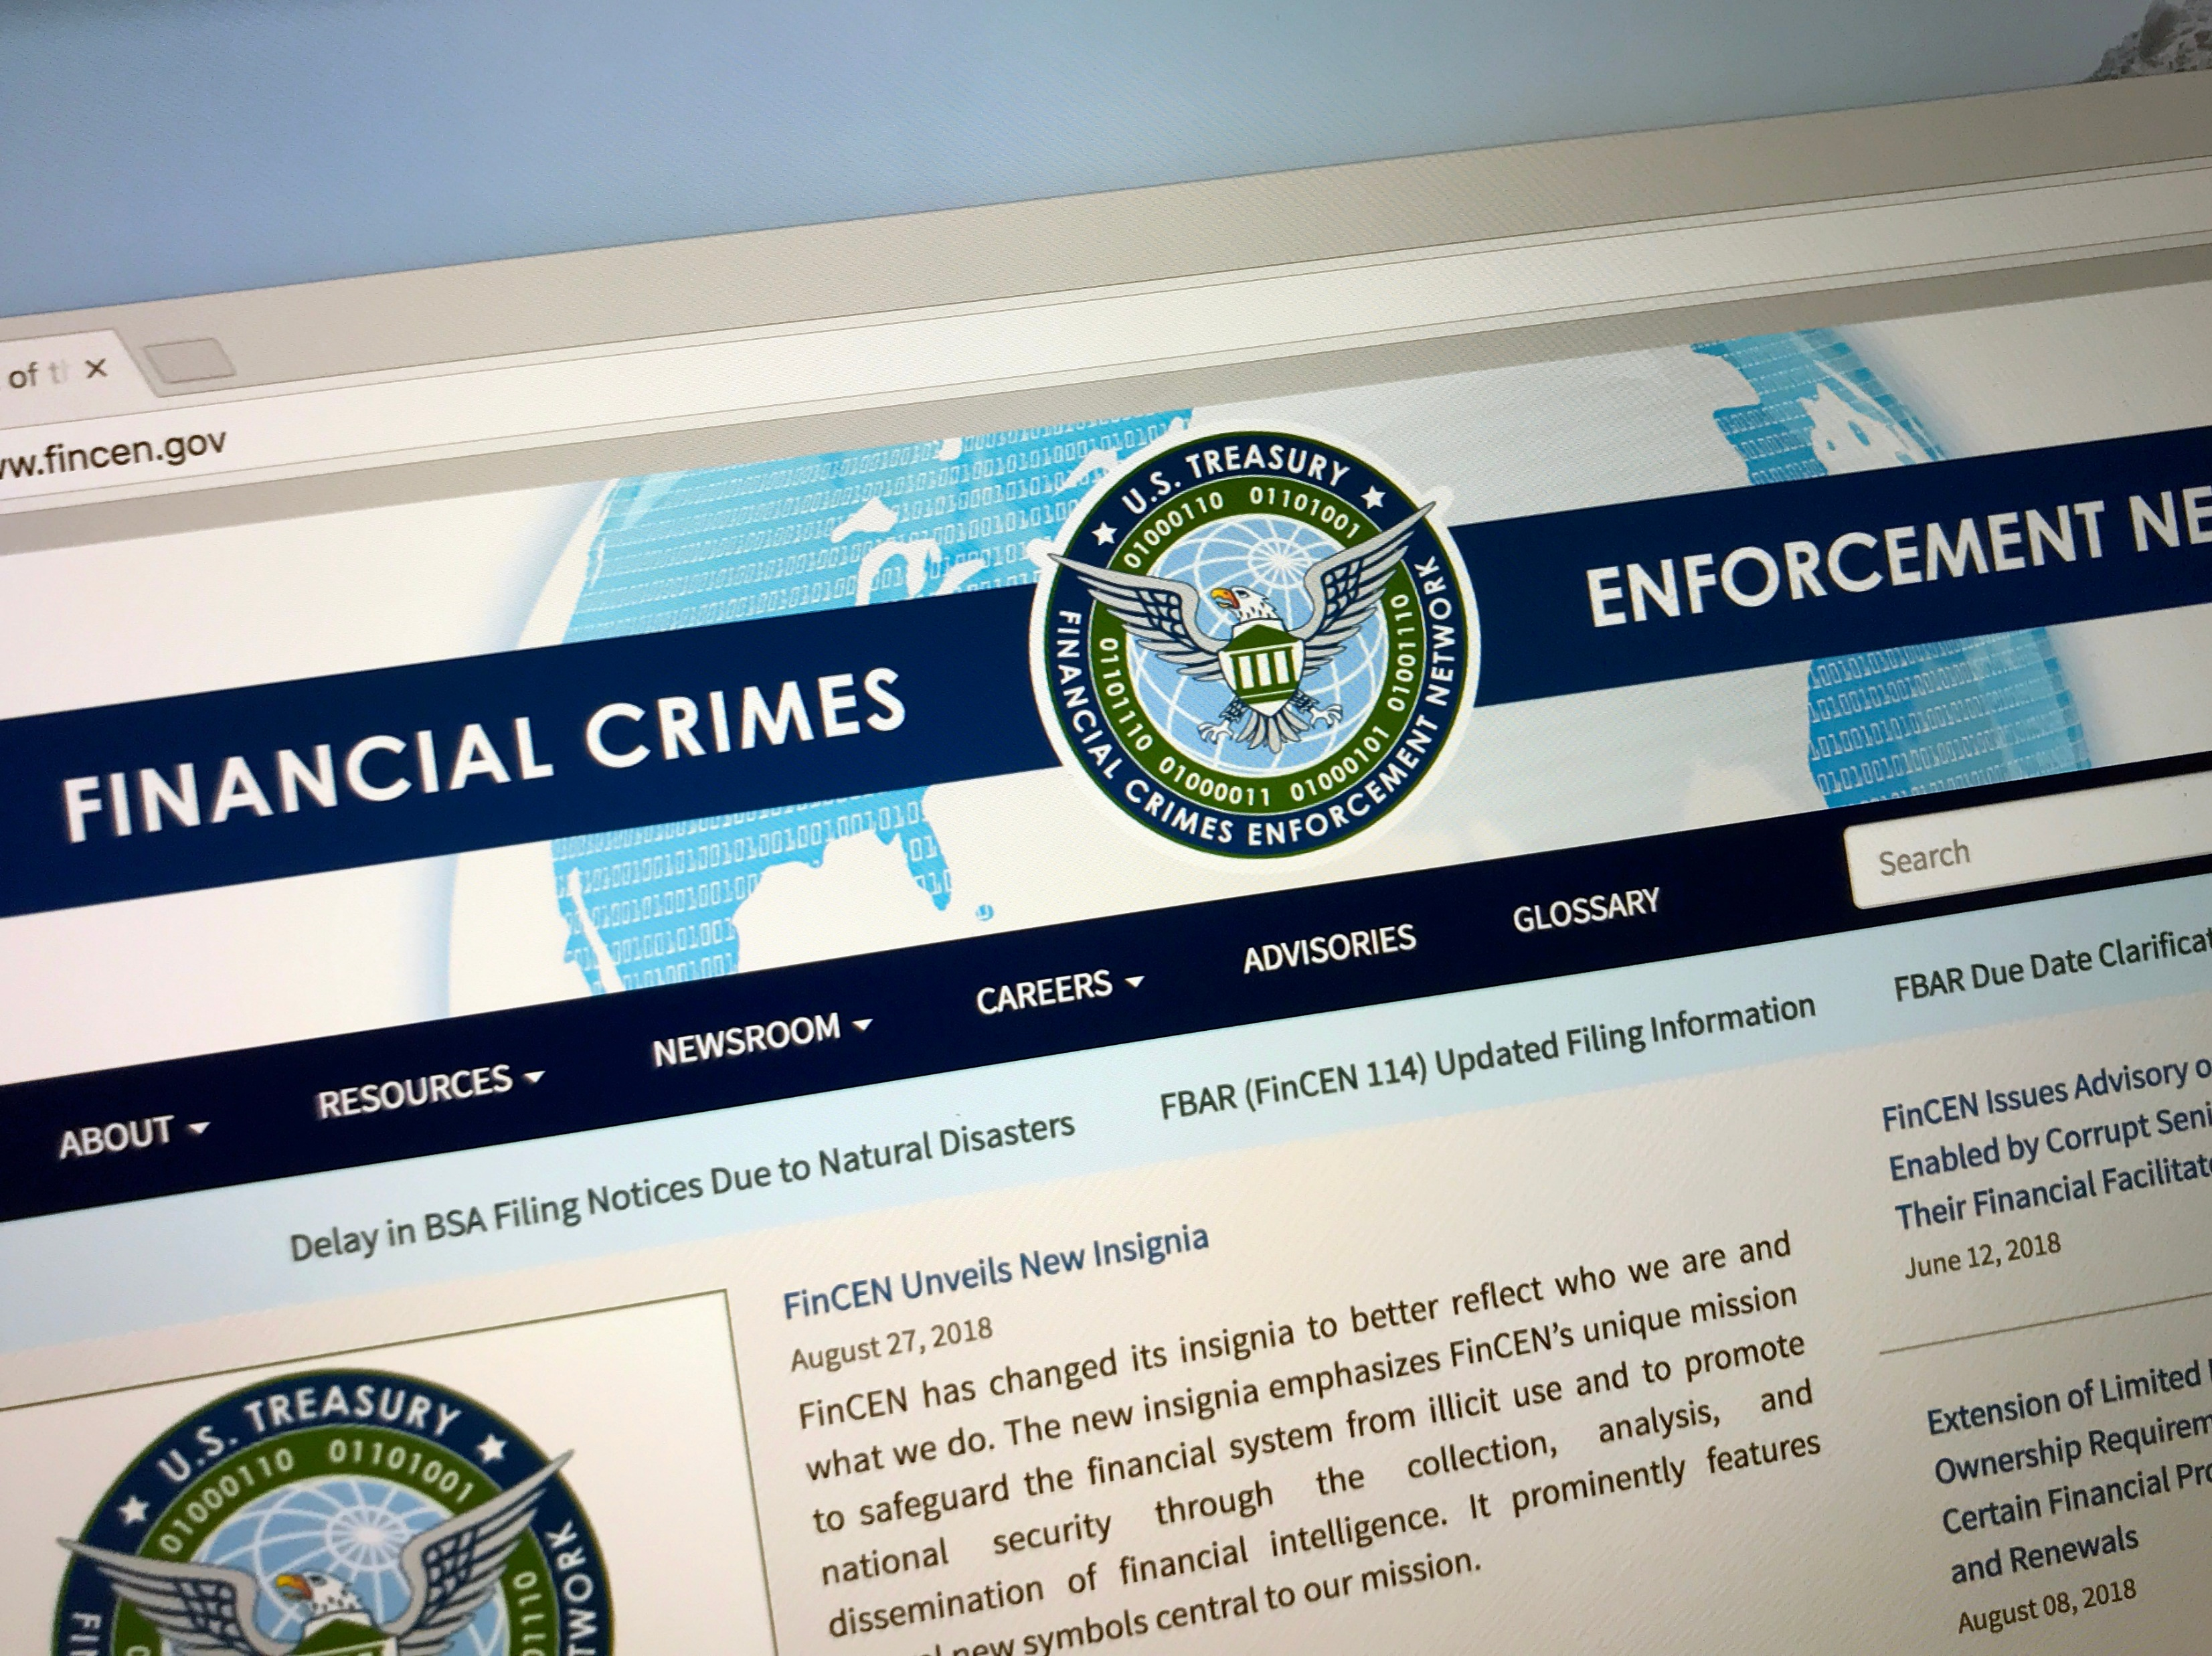
Latest on Beneficial Ownership Information Reporting

Slide 4

What is Beneficial Ownership Information Reporting?
  The Corporate Transparency Act (CTA), Pub. L. 116-283 § 6401, et seq., requires all non-exempted companies to report information about their company AND their beneficial owners to FinCEN, a federal agency, beginning in 2024.
Who Owns or Controls This Entity?

Slide 5

It Was a Long Time in the Making
  Many in Congress had been attempting for many years to pass legislation to address the problem of shell corporations contributing to financial crimes: money laundering, tax fraud, human and drug trafficking, foreign corruption, etc.
  Both chambers passed this law in 2020, but it was vetoed by the President.
  Two-thirds of Congress voted to override the veto, and it was enacted January 1, 2021.

Slide 6

Impact of Beneficial Ownership Information Reporting
  There was little fanfare at the time, but the impact of law is seismic.
    States are responsible for business registrations. This law introduces new federal requirements.
  This law impacts SMALL businesses, not large entities.
  This law requires more than 32 million businesses, including small LLCs, corporations, and limited partnerships, to file reports to disclose their beneficial owners in 2024 (+ 5 million new).

Slide 7
Who: Domestic and Foreign Reporting Companies
Entity Type | Reporting Entity (unless exempted)
LLC | Yes
SMLLC | Yes
General Partnership | No
Sole Proprietorship | Not unless corporation or LLC
Limited Partnership | Yes
S Corporation | Yes
C Corporation | Yes
Trust | Not unless required to file with Secretary of State, but trustees or beneficiaries may be beneficial owners of other reporting entities

Slide 8

Administered by FinCEN
  The CTA requires the Financial Crimes Enforcement Network (FinCEN) to establish and maintain a national registry of beneficial owners of entities that are otherwise not subject to disclosure regulations.
    FinCEN is a bureau of the U.S. Treasury.
  Unauthorized use or disclosure of beneficial ownership information (BOI) may be subject to criminal and civil penalties.
    THIS IS NOT A TAX LAW. THE IRS IS NOT IN CHARGE.

Slide 9
When Must Reports Be Filed?
    Reporting companies created or registered before January 1, 2024, have one year (until January 1, 2025) to file their initial reports.
    Reporting companies created or registered after January 1, 2024, but before January 1, 2025, have 90 days after creation to file their first report.
    Reporting companies created on or after January 1, 2025, will have 30 days after creation or registration to file their initial reports.
  Once the initial report has been filed, both existing and new reporting companies will have to file updates within 30 days of a change in their beneficial ownership information.
    Any reporting company that no longer meets the requirements of an exemption from reporting shall file its report within 30 calendar days after it no longer qualifies for the exemption.

Slide 10
But Wait…Is this Law Constitutional?
    On March 1, 2024, in the case of National Small Business United v. Yellen, No. 5:22-cv-01448 (N.D. Ala.), a federal district court in the Northern District of Alabama, Northeastern Division, entered a final declaratory judgment, concluding that the Corporate Transparency Act exceeds the Constitution’s limits on Congress’s power and enjoining the Department of the Treasury and FinCEN from enforcing the CTA against the plaintiffs.
      https://cases.justia.com/federal/district-courts/alabama/alndce/5:2022cv01448/183445/51/0.pdf?ts=1709398196
    Court said Congress did not possess the power to pass this law under:
      Foreign Affairs Power
      Commerce Clause OR
      Taxing Power

Slide 11
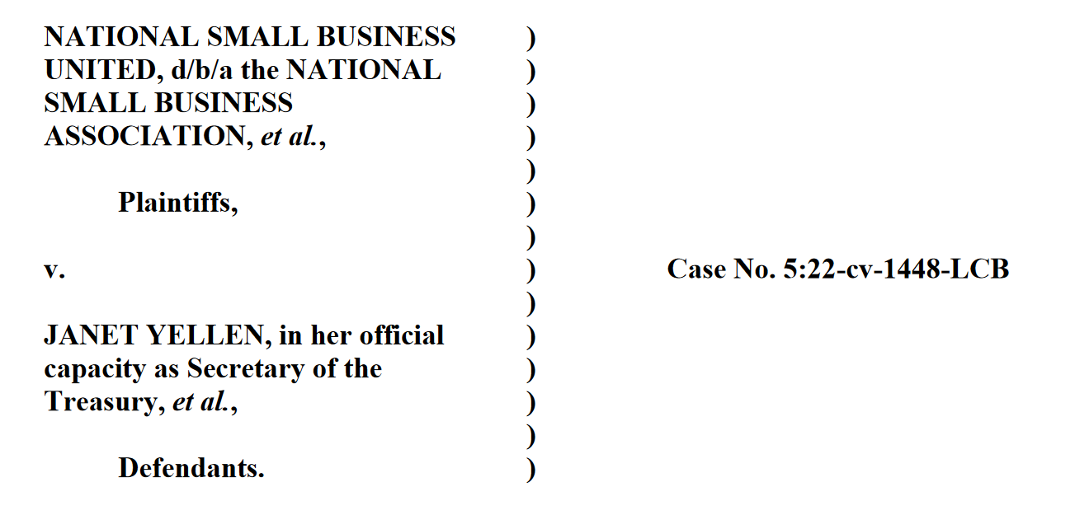
Notice of Appeal Filed
    The Justice Department, on behalf of the Department of the Treasury, filed a Notice of Appeal on March 11, 2024.
      The Government says that the CTA is within Congress’ broad powers to regulate commerce, oversee foreign affairs and national security, and impose taxes and related regulations.

Slide 12

What are the Chances of 11th Circuit Affirming?
    It is unclear what will happen. Congress’ power under the Commerce Clause is very broad.
      In modern times, few laws have been struck down using this argument.
      Congress could intervene and restructure the law to address some concerns.

Slide 13
Additional Lawsuits
    Boyle v. Yellen, No. 2:24-cv-00081 (D. Maine) (Maine business owner seeking injunctive relief against the CTA, asserting his LLCs conduct only intrastate business)(argues the case violates federalism and the 9th and 10th Amendments).
    Gargasz v. Yellen, No. 23-cv-02468 (N.D. Ohio) (licensed attorney and legal association seeking a nationwide injunction).
    Small Business Association of Michigan v. Yellen, No. 1:24-cv-00314, (W.D. Mich.) (Arguing the law is unconstitutionally vague: the definition of beneficial owner includes anyone who “exercises substantial control over the entity,” whether “directly or indirectly, through any contract, arrangement, understanding, relationship, or otherwise.”)(injunction hearing has been held).

Slide 14
Additional Lawsuits
    NFIB v. Garland, Filed May 28, 2024, in Eastern District of Texas
      CTA unconstitutionally compels speech
      CTA violates Commerce Clause

Slide 15
How Does Litigation Impact Filing Requirements?
    While this litigation is ongoing, FinCEN will continue to implement the Corporate Transparency Act as required by Congress, while complying with the court’s order.
    FinCEN has said that it will not enforce the CTA against the plaintiffs in that action:
        Isaac Winkles, reporting companies for which Isaac Winkles is the beneficial owner or applicant, the National Small Business Association, and members of the National Small Business Association (as of March 1, 2024)(approximately 65,000 members).
        Only those individuals and entities are not required to report beneficial ownership information to FinCEN at this time.

Slide 16
How Might Pending Litigation Impact Filing Decisions?
    Newly formed entities MUST file within 90 days.
    Entities existing before January 1, 2024, MAY want to wait a bit before filing to see if any new developments arise.
      Reports for these entities MUST be filed by January 1, 2025.
    Updates for reports that are filed MUST be filed within 30 days.

Slide 17

A Few Common Issues

Slide 18
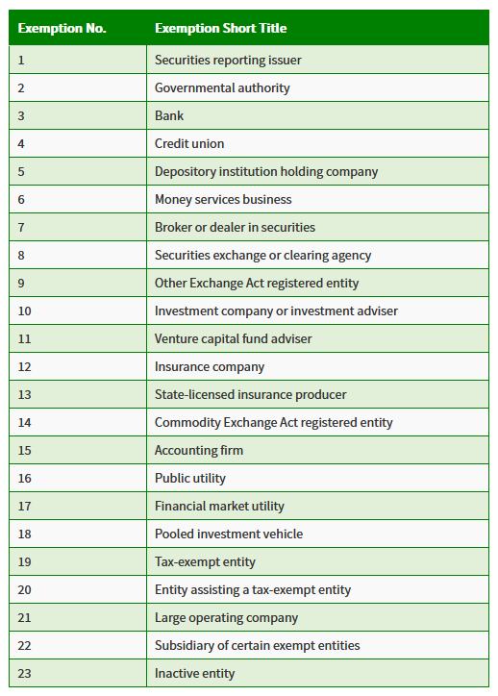
Exceptions to Reporting
  The FinCEN rule lists 23 types of entities that are specifically excepted from reporting requirements.
  These are generally excluded from the reporting requirements because other laws regulate these entities and separately require disclosure of BOI.
  Be very careful about looking just at categories. Devil is in the details.

Slide 19
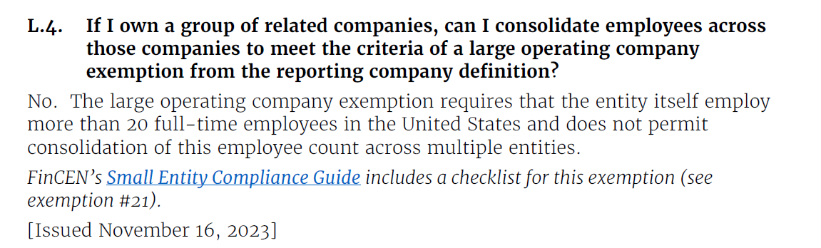
Exceptions to Reporting – Some Examples
  Large Operating Companies are exempt if:
    They employ more than 20 full-time employees in the United States.
    They have filed a Federal U.S. income tax return for the previous year that showed more than $5,000,000 in gross receipts or sales.
    They operate from physical premises in the United States.

Slide 20
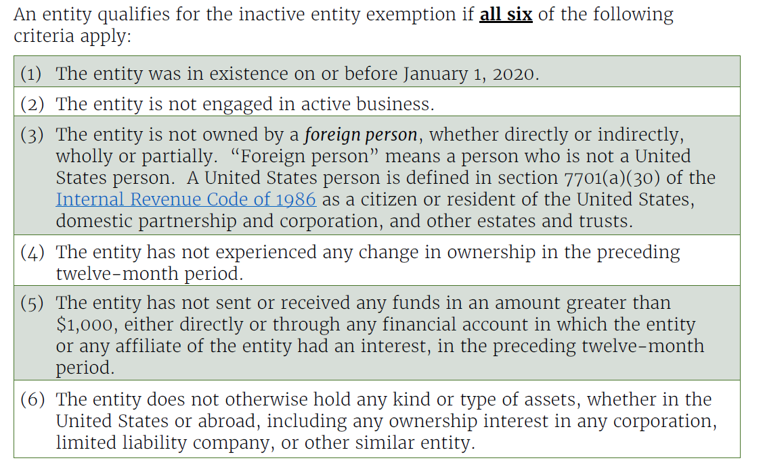
Exceptions to Reporting – Inactive Entities

Slide 21
Exceptions to Reporting – INACTIVE ENTITIES
  With respect to questions regarding the treatment of company termination or dissolution, “FinCEN does not expect a reporting company to file an updated report upon company termination or dissolution.”
  FinCEN retains Applicant and Beneficial Owner information on an ongoing basis for at least five years after the reporting company terminates. § 5336(c)(1).

Slide 22
Who: Beneficial Owners
  In general, beneficial owners are individuals who:
  directly or indirectly exercise “substantial control” over the reporting company, or
  directly or indirectly own or control 25% or more of the “ownership interests” of the reporting company.

Slide 23
What: Reporting Details
  A reporting company must disclose:
    its full legal name and any trade name or DBA;
    a complete address, including the street address of the principal place of business for U.S. companies and primary U.S. location for other businesses;
    the State, Tribal, or foreign jurisdiction in which it was formed or first registered, depending on whether it is a U.S. or foreign company; and
    its Taxpayer Identification Number (TIN)(i.e., EIN)

Slide 24
What: Reporting Details
  For each beneficial owner and each company applicant (if required), the company must provide the individual’s:
    full legal name
    birthdate
    a complete address
        For company applicants who form or register an entity, this includes the street address of the company applicant. For all individuals, beneficial owners and applicants, the address must be the residential street address of the individual.
    an identifying number from a non-expired driver’s license, passport, or other approved document for each individual, as well as an image of the document from which the document was obtained

Slide 25
What: FinCEN Identifier
  An individual (beneficial owner or company applicant) or reporting company may obtain a FinCEN identifier by submitting an application at or after the time that the reporting company submits its initial report.
  Each identifier is specific to the individual or reporting company.
  If an individual has obtained a FinCEN identifier, the reporting company may use that identifier in its report instead of listing all of the required information for the individual.
  A reporting company uses its FinCEN identifier to submit updated reports, as required.

Slide 26
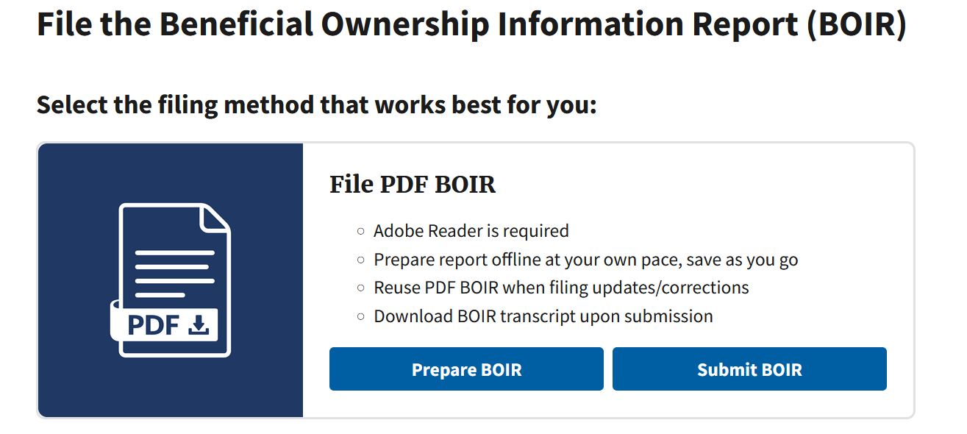
How to File
https://boiefiling.fincen.gov

Slide 27
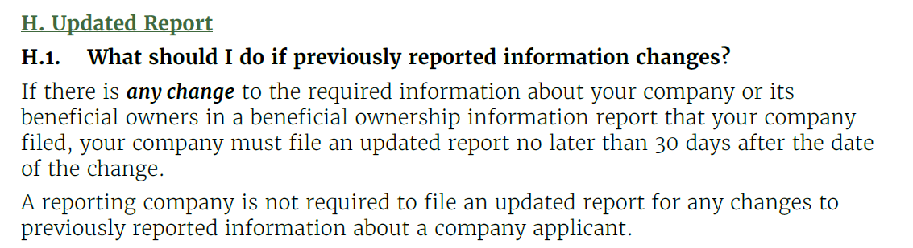
Updating Reports

Slide 28
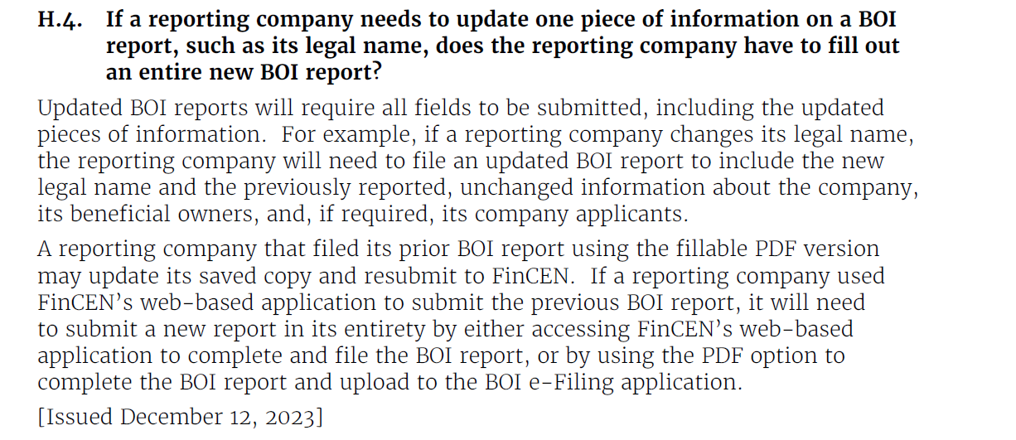

Slide 29
Penalties for Noncompliance

Slide 30
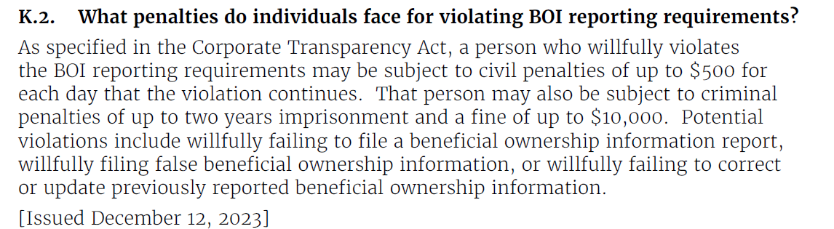
Penalties for Noncompliance

Slide 31
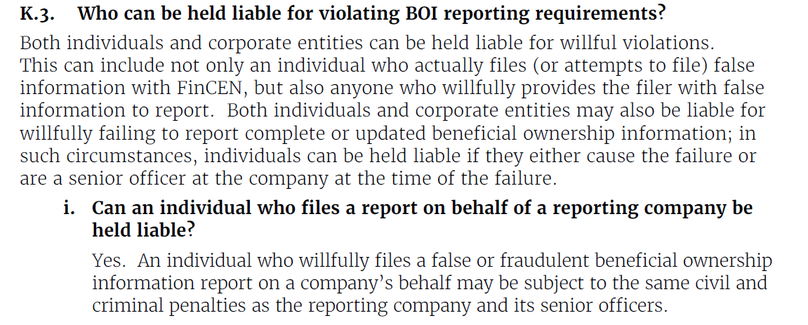
Who is Responsible?

Slide 32
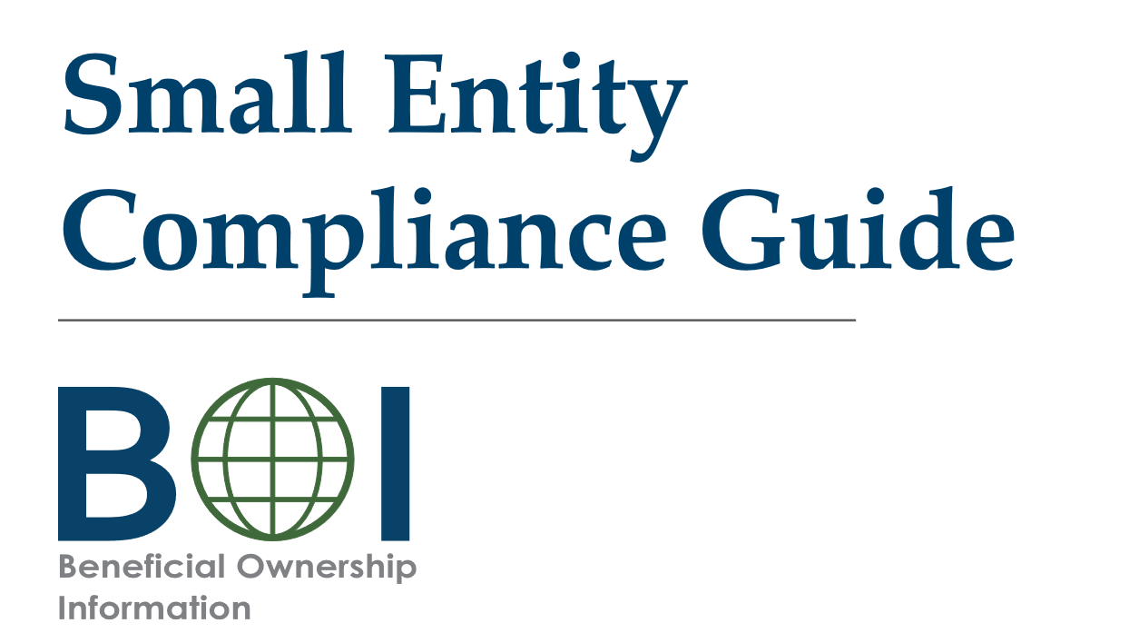
Small Business Compliance Guide (Best Resource)
https://www.fincen.gov/boi/small-entity-compliance-guide
https://fincen.gov/boi-faqs

Slide 33
Professional Concerns
Attorneys who form entities for clients MUST stay on top of these requirements and advise clients with respect their obligations. Failure to do so may constitute a failure to advise.
  Most will have multiple staff members who are company applicants.
When professionals assist clients, they need to be clear about responsibilities to provide updates.
Engagement letters should clearly set forth the responsibilities and obligations of the clients and the advisors.
Professionals must work with professional liability insurers.
Non-lawyer tax professionals may not be able to assist clients with CTA obligations without running afoul of unauthorized practice of law statutes.

Slide 34
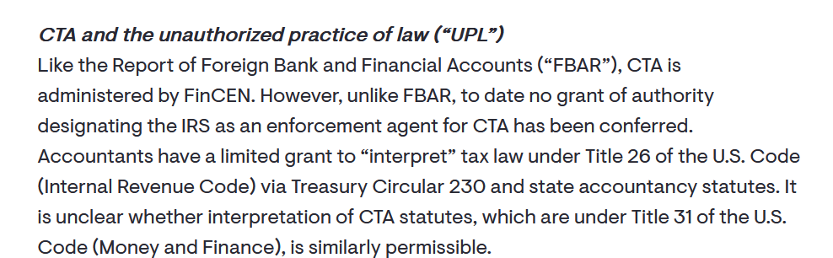
Practice of Law?

Slide 35

Scheduled Sunset of Income Tax
Provisions in 2025

Slide 36
What’s the Big Deal?
    In 2017, Congress passed the most impactful tax bill in 30 years.
    The Tax Cuts & Jobs Act signed into law December 22, 2017, provided lower tax rates for individuals, a new 20 percent deduction for qualified pass-through business income, a 21 percent flat tax rate for corporate income, and changes impacting depreciation, expensing and losses.
    Because it was passed via the budget reconciliation process, it had a shelf life. That expiration date is December 31, 2025.
    It was estimated to cost $1.9 trillion to implement ($5.5 trillion in tax breaks and $4 trillion in offsets). It is estimated to cost ~ $5 trillion to extend it.

Slide 37

Higher Individual Tax Rates Are Scheduled
    Most farm businesses are sole proprietorships, partnerships, or S Corporations. This means that business income passes through to the owners, who pay taxes based upon individual income tax rates.
    From 2018 to 2025, the TCJA lowered individual income tax rates across the board.

Slide 38
Higher Individual Tax Rates Are Scheduled
    The graduated rates that apply to ordinary income were also restructured to include the following brackets: 10%, 12% (down from 15%), 22% (down from 25%), 24% (down from 28%), 32% (down from 33%), 35%, and 37% (down from 39.6%).
    Also changed the income tax brackets to make more income subject to lower tax rates.
    On January 1, 2026, the tax rates and brackets will reset to pre-2018 levels.

Slide 39
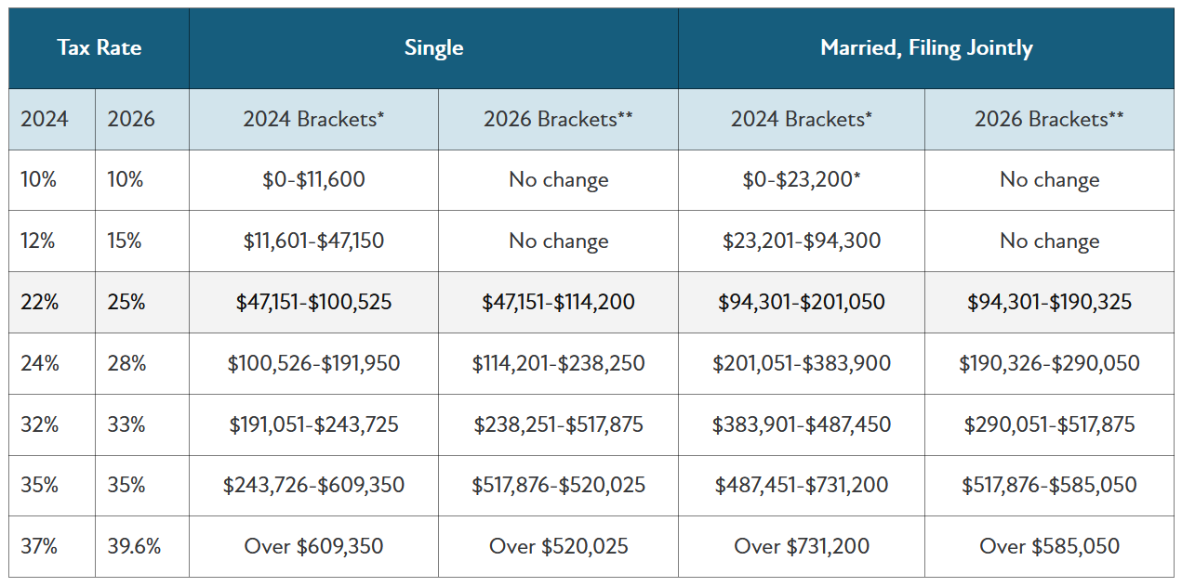





Lower Individual Tax Rates

Slide 40




Increased Standard Deduction Scheduled to Sunset
    Taxpayers only itemize deductions if the amount they can deduct on 1040, Schedule A, is more than their standard deduction. The TCJA has significantly decreased the number of taxpayers who itemize deductions by nearly doubling the standard deduction.
    In 2018, it increased the standard deduction from $13,000 to $24,000 for married filing jointly taxpayers and from $6,500 to $12,000 for single taxpayers. [I.R.C. § 63].
    For 2023 returns, these standard deduction amounts are $27,700 for married filing jointly and $13,850 for singles.
    The increased standard deduction is in place through 2025 and will reset to prior levels, indexed for inflation, in 2026.

Slide 41
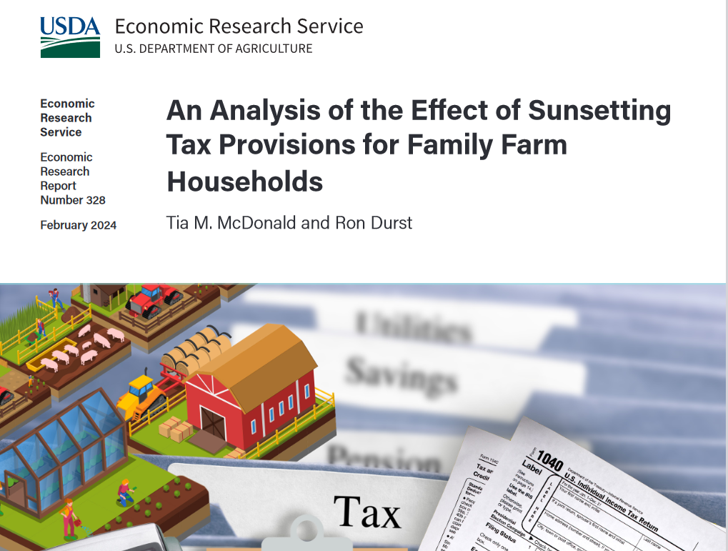
Impact of Expiring Provisions on Farmers
https://www.ers.usda.gov/webdocs/publications/108636/err-328.pdf?v=2901.3

Slide 42
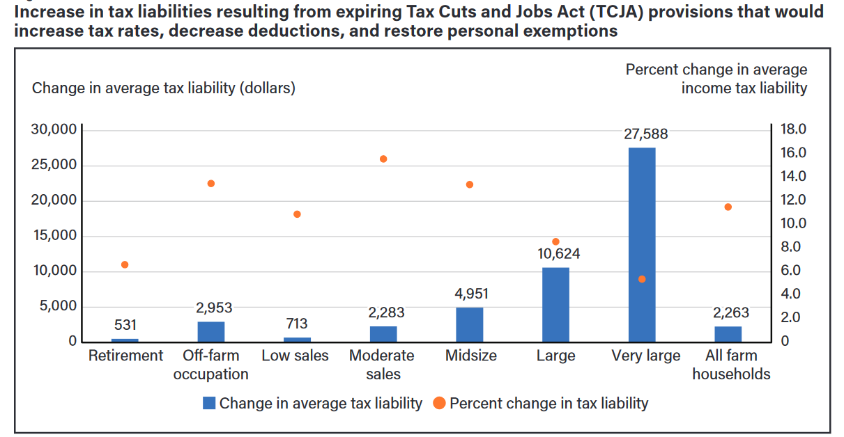
Impact

Slide 43
Child Tax Credit
    The TCJA raised the child tax credit from $1,000 to $2,000 per qualifying child for tax years 2018 through 2025. [I.R.C. § 24(h)(2)].
    Of this credit, $1,400 per child is refundable.
    The TCJA also created a new $500 nonrefundable credit for each dependent who does not qualify for the child tax credit, including those over the age of 16.
    Note: During COVID, this CTC was increased to $3,000 - $3,600 per child, with no earned income required and full refundability!

Slide 44
Child Tax Credit
    In addition to receiving a larger child tax credit, many more families have qualified for the child tax credit under the TCJA because the phase-out of the credit does not begin until a married filing jointly couple reaches an adjusted gross income of $400,000 or a single taxpayer reaches an adjusted gross income of $200,000.
    In 2026, the $1,000 credit per child will begin to phase out when the married filing jointly couple has modified adjusted gross income above $110,000 and the single taxpayer has modified adjusted gross income above $75,000.

Slide 45
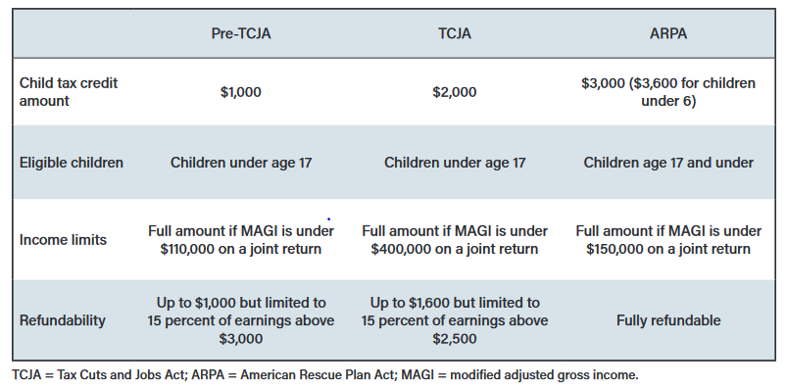
Child Tax Credit

Slide 46
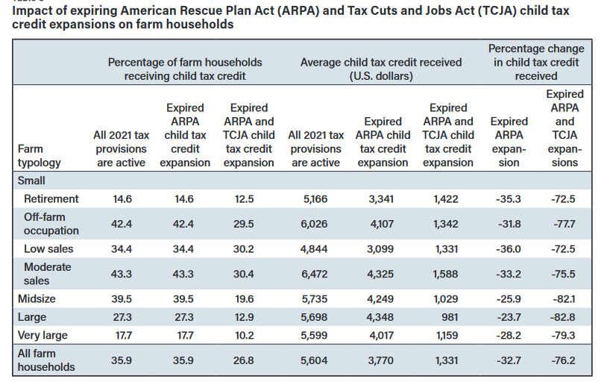




Child Tax Credit

Slide 47
Qualified Business Income Deduction
    For tax years 2018 through 2025, the TCJA allows most individuals receiving income from a sole proprietorship or a pass-through business—including an S corporation or a partnership—to take a 20% qualified business income deduction (QBI deduction). [I.R.C. § 199A].
    Additionally, agricultural cooperatives are allowed to take a I.R.C. § 199A(g) deduction or pass that deduction through to their patrons, similar to the old domestic production activities deduction (DPAD) under I.R.C. § 199.
    Impact = tax rate * 20 percent.

Slide 48
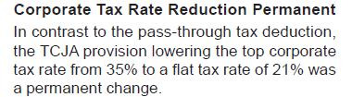
Qualified Business Income Deduction
    Section 199A is set to expire in 2026. This will significantly impact small businesses, as well as agricultural cooperatives and their patrons.
    The DPAD deduction provided by I.R.C. § 199, was permanently repealed by the TCJA in 2018.

Slide 49
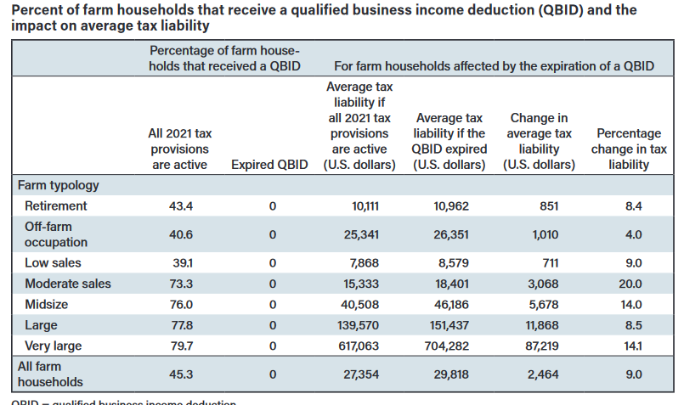







Qualified Business Income Deduction
    Section 199A is set to expire in 2026. This will significantly impact small businesses, as well as agricultural cooperatives and their patrons.
    The DPAD deduction provided by I.R.C. § 199, was permanently repealed by the TCJA in 2018.

Slide 50

Accelerated Cost Recovery Changes

Slide 51
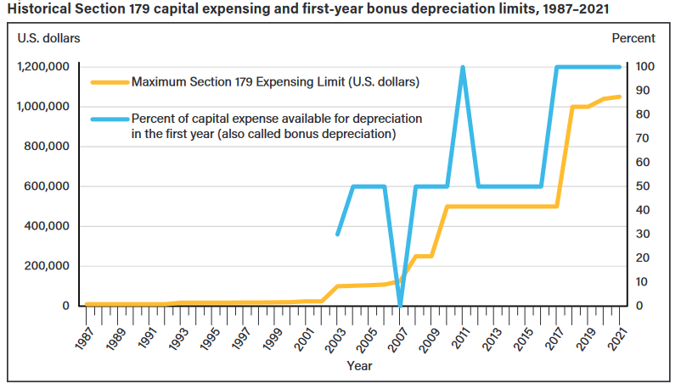
Taking Bonus and Section 179

Slide 52
Bonus Depreciation Phase-Out
    The scheduled phase-out is as follows:
          2023: 80 percent bonus
          2024: 60 percent bonus
          2025: 40 percent bonus
          2026: 20 percent bonus

Slide 53
Section 179
    A taxpayer may elect to treat the cost of any Section 179 property as an expense, deductible for the tax year in which the property is placed into service.
    The maximum I.R.C. § 179 deduction for 2023 is $1,160,000, reduced $1 for every $1 over the $2,890,000 investment limit.
    The limit in 2024 is $1,220,000, with an investment limit of $3,050,000.
    The SUV limit in 2023 is $28,080. It jumps to 2024 in $30,500.

Slide 54
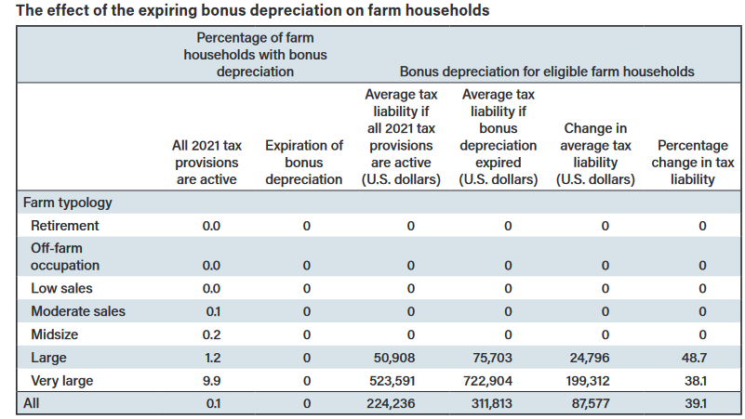





Taking Bonus and Section 179

Slide 55

Could We Still have Tax Legislation This Year?
On January 31, 2024, the House passed the “Tax Relief for American Families and Workers Act of 2024,” with a vote of 357 to 70.
It looked like it would pass, but then hit a roadblock in the Senate.
May 17 Update: Wyden, the Senate’s top tax writer told a group of corporate and tax executives that if the Senate can’t pass a $79 billion bipartisan bill, it doesn’t bode well for negotiations on a $4.6 trillion package in 2025. We’re going to win on this because we’re doing what Congress has promised.

Slide 56
Business Proposals
    Restoring 100 percent bonus depreciation through 2025.
    Slightly increasing Section 179 beginning in 2024.
    Restoring the ability of taxpayers to presently deduct domestic R&E expenditures incurred in 2022 through 2025.
    For purposes of the business interest deduction limit, calculating adjusted taxable income without including depreciation, amortization, and depreciation through the end of 2025.

Slide 57
Child Tax Credit Proposal
    The proposal would allow tax filers to multiply the amount calculated for the additional child tax credit by the number of children before applying the limit, beginning with the 2023 tax year.
    Additionally, the refundability limit of the credit would be increased to $1,800 per child for 2023, $1,900 per child for 2024, and $2,000 per child in 2025.
    The proposal would also apply inflation adjustments to the $2,000 credit, beginning in 2024.
    Finally, the proposal would allow tax filers to use their earned income from the current or prior year (whichever is greater) when calculating the 2024 and 2025 credit.

Slide 58

Just a Stop Gap until 2025

Slide 59

Consider Scheduled Tax Increases
    Noone can predict what Congress will look like or do in 2025, but consider scheduled sunset when making depreciation, expensing, and other decisions now. Chances are high that tax rates are going up, not down!

Slide 60

Sunset of Increased Estate and
Gift Tax Exemption

Slide 61
Estate and Gift Tax
    Estate tax is based upon estate appraisal at fair market value at date of death or six months later.
    Exceptions include:
        “Special Use Valuation” based on a capitalization rate (up to $1,310,000 discount in 2023, $1,380,000 in 2024)
        Discounts for “minority shareholders”
        “Qualifying Conservation Easements”
    Each person has their own unified credit (for estate and gift tax).
      The unified credit results in everyone have a standard exemption (basic exclusion amount) from estate and gift tax.

Slide 62
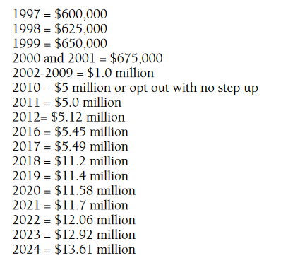
Exemptions Over Time

Slide 63
Almost Noone Pays it Today
    The USDA-ERS recently estimated that of the projected 39,534 estates created from principal farm operator deaths in 2022, only 305 (0.77 percent) will be required to file an estate tax return, and only 87 (0.22 percent) will likely owe Federal estate tax.

Slide 64

But Higher Exemption is Ending Soon…
    Increased exemption amount was created by the TCJA.
      It was only temporary, through December 31, 2025.
    In 2026, the exemption resets to $5 million, indexed for inflation (~$7 million).

Slide 65

Estate and Gift Tax Rate
    Although estate and gift tax rates are graduated, transfers in excess of the exemption are currently taxed at 40% because the present exclusion exceeds the top rate threshold of $1 million.

Slide 66
Portability
    Unused exclusion amount of spouse dying after 12/31/2010 may be used by surviving spouse
    Only available if election made on timely filed estate tax return (Form 706) of predeceased spouse – whether or not estate tax return is otherwise required.
    Spouses could apply up to $27.22 exemption in 2024.

Slide 67
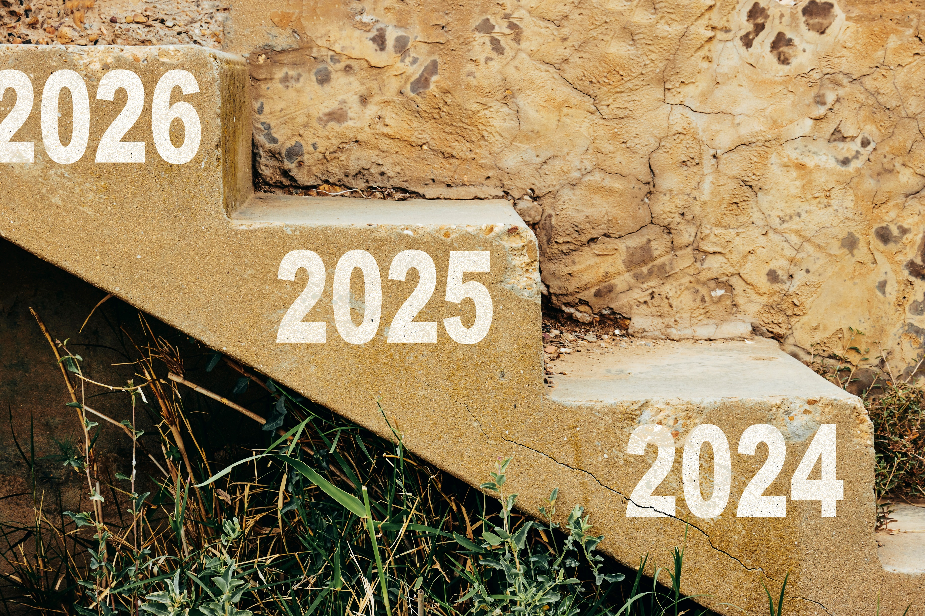
Planning for the Lower Exemption
    Noone can predict what Congress will do, but if an estate is above $5 million, planners should be working with clients on strategies.

Slide 68
Generally, No Clawback for Pre-2026 Gifts
    In T.D. 9884 (2019), IRS said there would be no clawback for lifetime gifts made before the exemption declines.
    Existing regulations would also apply DSUE in place at time of first spouse to die.
        This makes portability election more, not less, important.
        Would (in the absence of contrary future guidance) lock in the higher amount of exclusion for future years, even if exclusion decreases.

Slide 69
Example – Lifetime Gift
    Leeland made a $12 million lifetime gift in 2023.
    He filed Form 709. Leeland dies in 2026, after the exemption has reset to ~$7 million.
    Under T.D. 9884, Leeland’s full gift remains sheltered by the exemption in place in 2023.

Slide 70
Example – Lifetime Gift
    Laurie gave a $7 million gift in 2023. She filed Form 709.
    Laurie dies in 2026 after the exemption resets to ~$7 million.
    Although Laurie could have gifted up to $12.92 million in 2023, she has no exclusion remaining at her death.
    Any property passed to her heirs at death will be subject to a 40% estate tax.

Slide 71
Example – Portability
    Lucy died in 2023, leaving a $12.92 million deceased spouse unused exclusion.
    Lucy’s surviving spouse, Syd, elected portability as the executor.
    Syd dies in 2026 after the exemption resets to ~$7 million.
    Current regulations would allow Lucy’s $12.92 million DSUE to apply to Syd’s estate.
    Syd would therefore have ~$19.92 million exemption.

Slide 72
Example – Portability
    If Syd had not elected portability when Lucy died, Syd would have only a ~$7 million exemption at his death.

Slide 73
Late Portability Election Extended to Five Years
  Rev. Proc. 2022-32
    Under the recent procedure, which supersedes. Rev. Proc. 2017-34, an extension request must be made on or before the fifth anniversary of the decedent's death.
    This simplified method, which doesn't require a user fee, should be used in lieu of the letter ruling process.

Slide 74


