Slide 1


Lindsay S. C. Brinton
Meghan S. Largent
600 Washington Ave | Suite 2500 | Saint Louis, MO | www.lewisrice.com

Slide 2
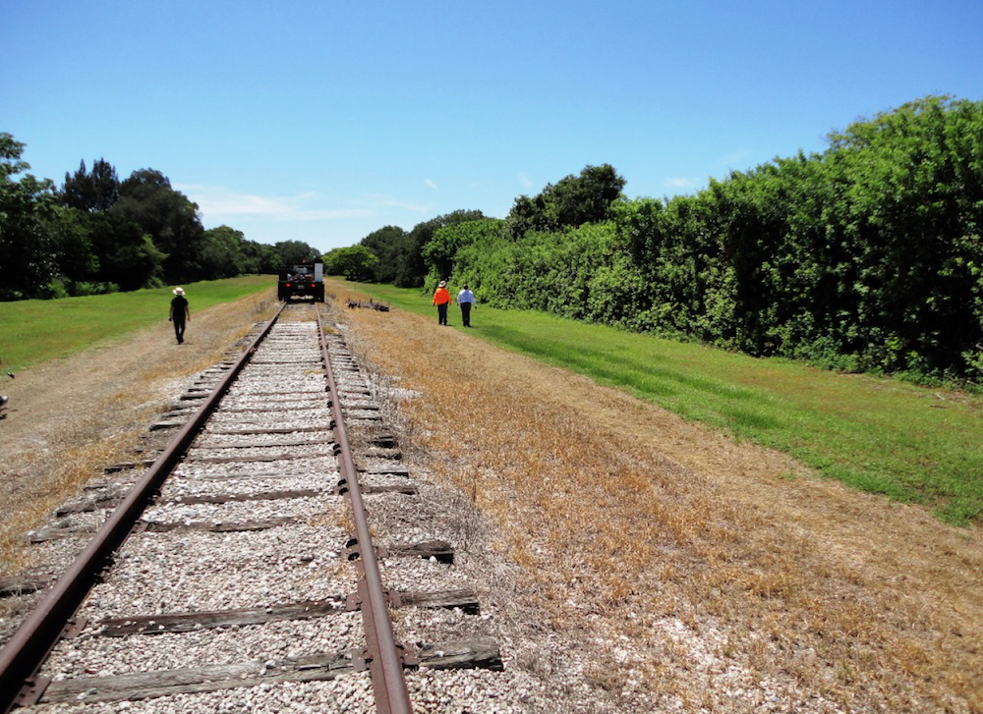
What are “Rails-to-Trails” Cases?
The “before” picture – a former railroad right-of-way is abandoned under state law

Slide 3
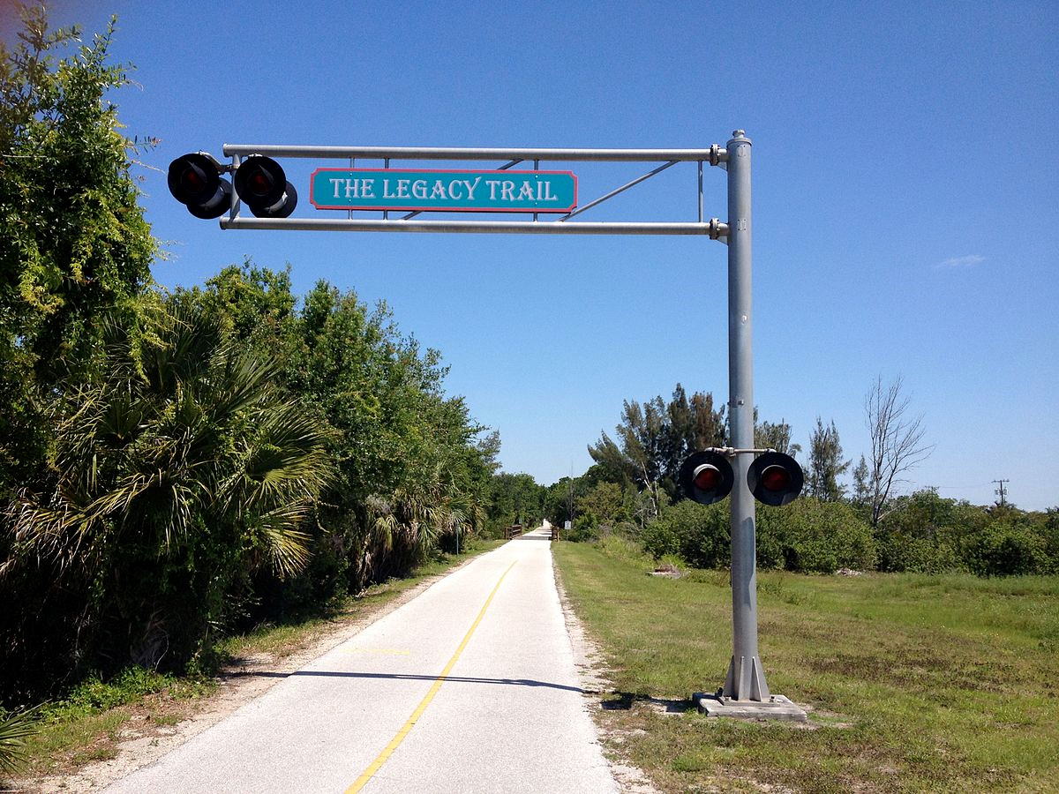
What are “Rails-to-Trails” Cases?
The “after” picture – pursuant to federal law, the former railroad right- of-way is converted to a public linear park

Slide 4
Railroad Acquires Right-of-Way
by One of Three Ways
Written conveyance from landowner
  Landowner executes document conveying right or land to the railroad to use land for a railroad right-of-way
  Can be either easement (right) or fee (land) depending on state law
Condemnation
  Landowner did not willingly convey property to railroad
  Railroad used its power of eminent domain to condemn owner’s land for use as a railroad right-of-way
  In most states (not VA), only a limited easement is conveyed
Prescriptive Easement/Charter
  Similar to adverse possession
  Railroad has no written document by which it acquired its right-of-way
  Railroad used its power of eminent domain to build right-of-way
  In most states, only a limited easement is conveyed

Slide 5
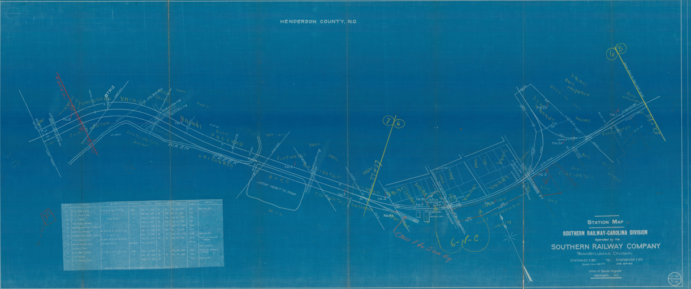
Railroad Ownership Documented in Valuation Map

Slide 6
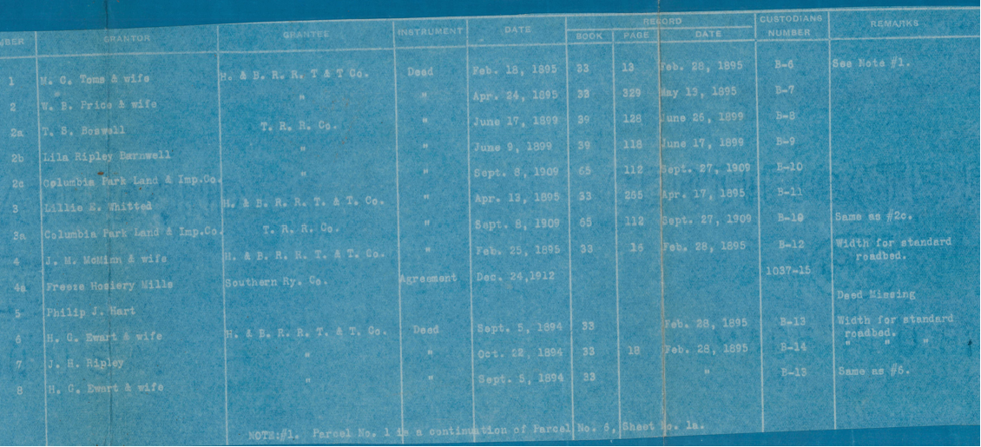
Railroad Ownership Documented in Valuation Schedule

Slide 7
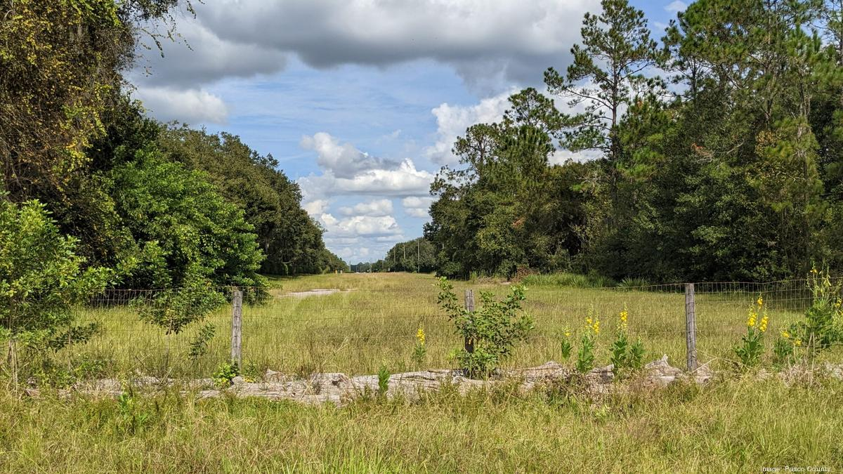
Under State Law, RR Easement Extinguished Upon Abandonment

Slide 8
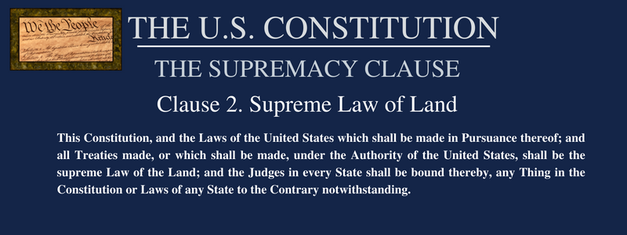
Federal Law Preempts State Law

Slide 9


What are “Rails-to-Trails” Cases?
The Plaintiffs
  Landowners owning land adjacent to former railroad right-of-way
The Defendant
  The federal government – represented by the Department of Justice
The Court
  U.S. Court of Federal Claims – located in Washington, DC
The Law
  The federal “Trails Act”

Slide 10
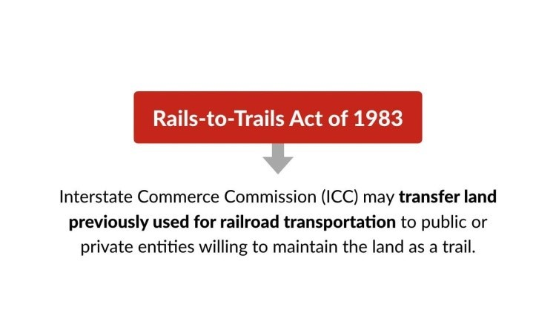
What is “The Trails Act”?
In 1968, National Trails System Act was enacted (16 U.S.C. Sections 1241 – 1251)
In 1983, Congress added a rail section (16 U.S.C. Section 1247(d)):
“such interim use shall not be treated, for purposes of any law or rule of law, as an abandonment of the use of such rights-of-way for railroad purposes.”

Slide 11
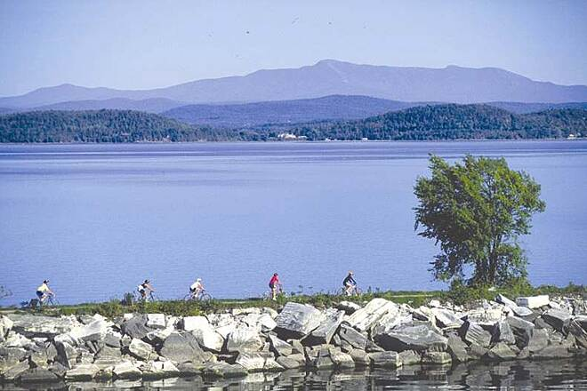
Presault v. ICC, 494 U.S. 1 (1990)

Slide 12
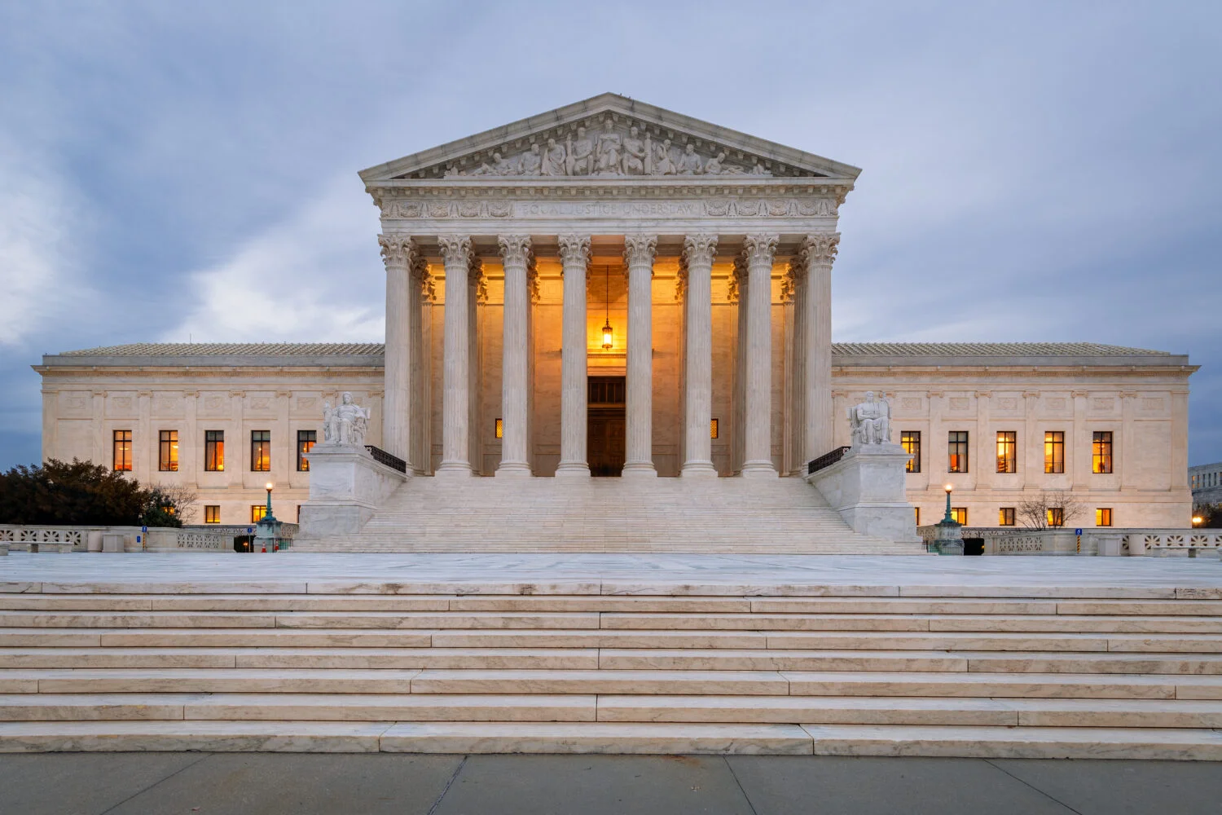
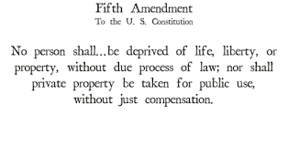
Presault v. ICC, 494 U.S. 1 (1990)
HELD: The Trails Act is “a valid exercise of congressional power under the Commerce Clause”
BUT:
Compensation may be due under the Fifth Amendment

Slide 13
How Do Trails Act Takings Cases Begin?
The Surface Transportation Board
Federal agency with jurisdiction over all railroads in interstate commerce
“Abandonment Proceedings”
Railroad applies to the STB to abandon service across the right-of-way
Must certify the line has not been used in at least two years
Too expensive to insure, maintain and won’t affect shippers on the line
Trail group files a trail use request, asking the STB to issue a Notice of Interim Trail Use or Abandonment (“NITU”) authorizing the conversion
Railroad agrees to negotiate with trail group
NITU automatically issued; NITU can be renewed infinitely

Slide 14
The Importance of the NITU
Triggers six-year statute of limitations
  “We therefore hold that the appropriate triggering event for any takings claim under the Trails Act occurs when the NITU is issued. The NITU marks the ‘finite start’ to either temporary or permanent takings claims by halting abandonment and the vesting of state law reversionary interests when issued.”
  Caldwell v. United States, 391 F.3d 1226 (Fed. Cir. 2004)
  Affirmed in Barclay v. United States, 443 F.3d 1368 (Fed. Cir. 2006)
Interest begins accruing until date of payment
Relevant date for measuring damages
Ownership after this date immaterial

Slide 15
WHAT HAPPENS WHEN THE NITU IS ISSUED?
The issuance of a NITU will likely take your Mississippi property rights by imposing two new easements on your land:
Public-access recreational trail
Possible future railroad use
Per the Supreme Court’s decision in Preseault v. I.C.C.,494 U.S. 1 (1990), this is a constitutional taking, but under the Fifth Amendment, the government must compensate you.

Slide 16
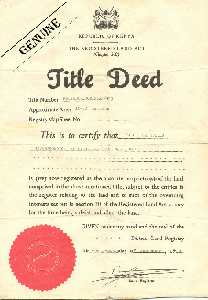


How Do Property Owners Make a Claim for Compensation?
The case is usually separated into three phases:
  Title
  Liability
  Damages

Slide 17
Must Prove Ownership on Date of Taking
Must be record owner on date of issuance of the NITU
Established by owner’s deed and tax records
Marriages, divorces, and deaths can cause complication in title
Typically resolved through settlement

Slide 18
Liability turns upon 3 questions
Ellamae Philips Co. v. United States,
564 F.3d 1367 (Fed. Cir. 2009):
Did the railroad have only an easement over the property owners land?
Was that easement limited to use of the easement for railroad purposes?
Even if the easement was not so limited, would the easement have otherwise been abandoned under state law?

Slide 19
Damages consist of three components
Property Value
  Individual appraisals
  Difference in “before” and “after” scenario
  Comprised of actual value of the land taken (“the dirt value”) and severance damages
Interest
  Moody’s AAA rate from “date of taking” until final payment
Attorneys’ Fees/Costs
  Contingency Fee
  Uniform Relocation Act (42 U.S.C. § 4654(c) (2000))

Slide 20
Severance damages measure impact of taking on entire parcel
Cost to cure damages can be added to cure the impact of the government’s taking. This can include damages for:
  Fencing
  Landscape berms
  Walls
Bisected properties may be impacted by loss of access, inability to farm, and loss of point rows
Access can be concern for undocumented access over the right-of-way to access a property
Improvements located within the right-of-way may need to be removed

Slide 21
Filing a Claim for Compensation Does Not Affect a Landowner’s Property
A claim for compensation is a constitutional right
It is a request for compensation as guaranteed by the Fifth Amendment
A claim does not affect the rail-trail easement
A claim has no impact on development or creation of the trail
Filing a claim is the only way to be paid for the taking of private property.

Slide 22
Case Study – Loss of Access and
Encroachments Within Take

Slide 23
Case Study – Farm Bisected by Right-of-Way

Slide 24
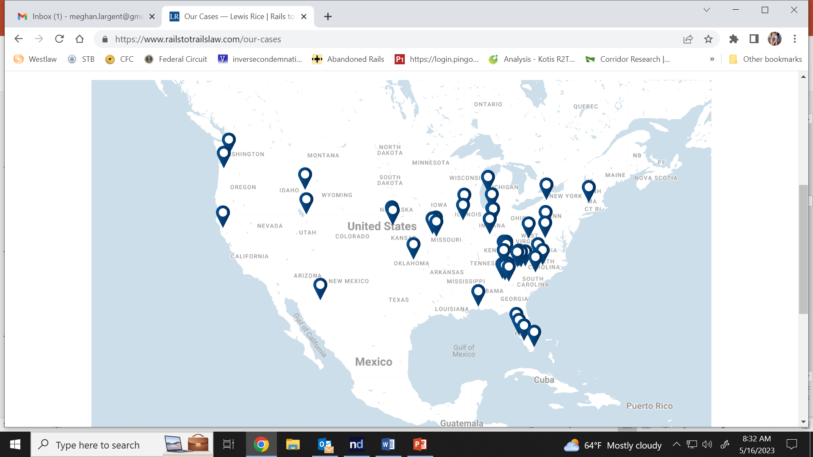
Our Experience Representing Landowners Across the Country

Slide 25
Lindsay S. C. Brinton
lbrinton@lewisrice.com
(314) 444-7723
Meghan S. Largent
mlargent@lewisrice.com
(314) 444-7704

