Slide 1
An Overview of Geographical Indications and their Impacts on U.S. Agriculture
The National Agricultural Law Center I Webinar Series
Presented by Chloe Marie, Research Specialist
August 17, 2022, at 11:00 am (CDT)

Slide 2
What is a geographical indication?
An indicator – usually a name or a sign – found on a product packaging
Used to identify a a product originating from a specific geographical territory and whose unique features or reputation originate from said geographical territory
  There must be a link between the name of the product and its geographical origin
Used to identify both agricultural and non-agricultural products
Used to protect against usurpation or misuse of a product
Must be registered with the competent national authority

Slide 3
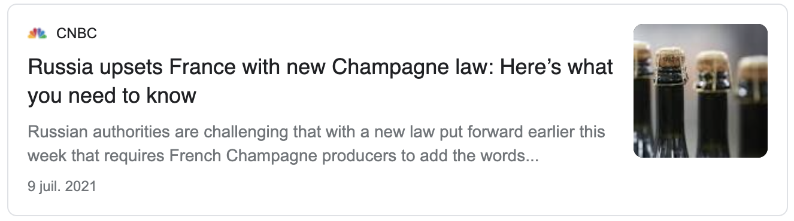
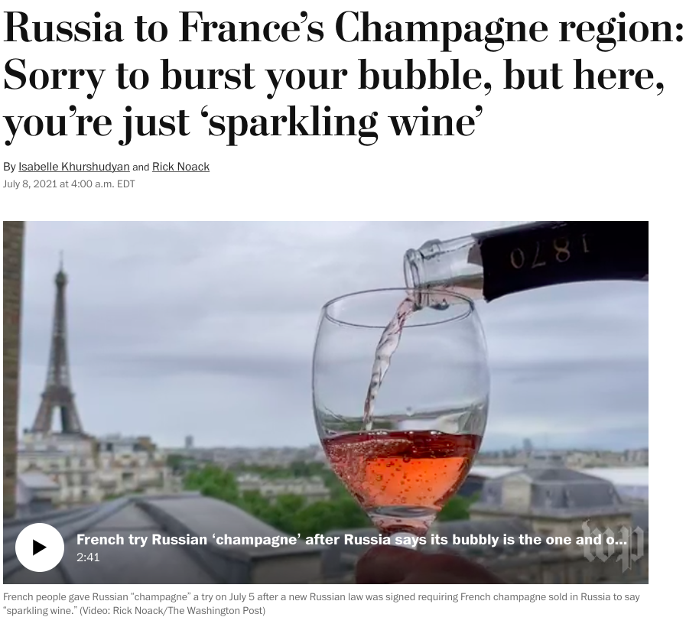
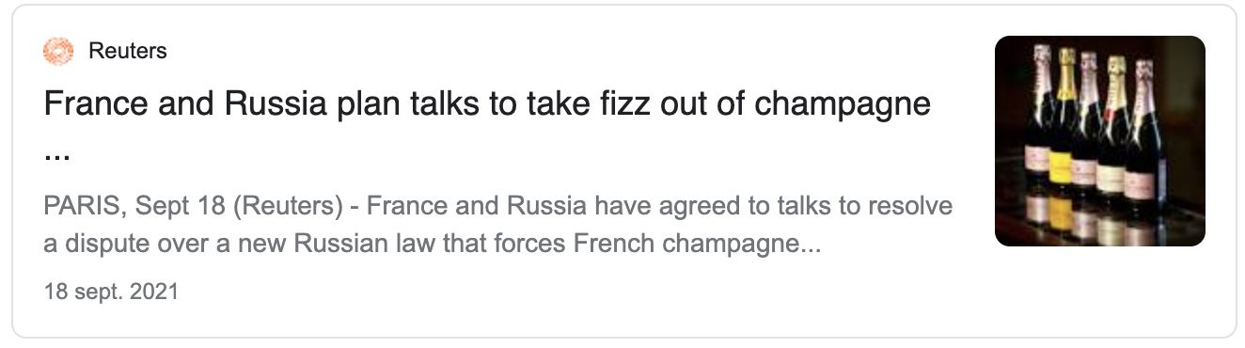
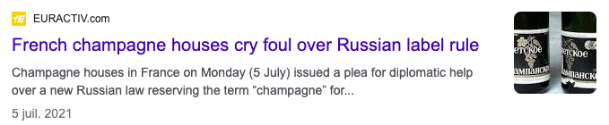

Slide 4
GI Multilateral Protection – TRIPS Agreement
Article 22
Provides definition of geographical indications (Article 22.1)
  “… indications which identify a good as originating in the territory of a Member, or a region or locality in that territory, where a given quality, reputation or other characteristic of the good is essentially attributable to its geographical origin.”
Provides basic level of protection for all products bearing geographical indications (Article 22.2-4)
  Requires each WTO member to provide “the legal means for interested parties” to prevent against (1) the misleading use of a geographical name for goods that do not originate from the indicated geographical area or (2) against the use of a GI that constitutes an act of unfair competition.
  Allows WTO members to refuse or invalidate the registration of a trademark consisting of a geographical indication if it misleads the public as to the origin of the good.
  Protects against the use of homonymous geographical names if it misleads the public as to the origin of the good.

Slide 5
GI Multilateral Protection – TRIPS Agreement
Article 23
Provides higher level of protection for geographical indications identifying wines and spirits
Requires each WTO member to provide “the legal means for interested parties” to prevent the use of a geographical indication identifying wines and spirits not originating in the area indicated by the geographical indication regardless of whether the public is being misled, there is unfair competition, or the geographical indication is followed by terms such as ‘kind,’ ‘type,’ ‘style,’ ‘imitation,’ or else (Art. 23.1).
Allows WTO members to refuse or invalidate the registration of a trademark consisting of a geographical indication as regards wines and spirits not having this geographical origin regardless of whether it misleads consumers (Art. 23.2)
Allows the coexistence of homonymous geographical indications provided that the homonymous indications can be differentiated from each other (Art. 23.3)
Requires WTO members to negotiate the establishment of a multilateral system of notification and registration of GIs for wines only (Art. 23.4)

Slide 6
GI Multilateral Protection – TRIPS Agreement
Article 24
Provides exceptions to the protection of GIs, including among others:
  WTO members do not have to protect GIs if the names they do protect are generic terms in their countries (Art. 24.6)
    A generic term is a common name referring to the nature or class of a product and must be understood as such by the public. Anyone can use a generic term.
    Ex: Cheddar, parmesan, brie, or mozzarella are generic cheese names in the U.S.
  The customary name of a grape variety may still be used despite its name being identical to a geographical indication identifying the product of the vine if the grape variety already existed prior to January 1, 1995 (Art. 24.6)
  Protection of GIs cannot conflict with trademark rights that have been previously acquired in good faith either (1) before the date of application of these provisions in that Member or (2) before the geographical indication became protected in its country of origin (Art. 24.5)
  Protection is not required for GIs that ceased to be protected in their country of origin or have fallen to disuse in that country (Art. 24.9)

Slide 7
GI Protection in the United States
In the U.S., GIs are protected as trademarks
  Section 4 of the Lanham Trademark Act of 1946
  The U.S. Patent and Trademark Office (PTO) allows the registration of GIs as a certification or collective marks
A certification mark is a type of trademark. It shows to consumers that a product 1) comes from a specific geographical area and 2) meets specified standards with respect to quality, material, mode of manufacture, etc.
A company generally owns a certification mark. It is the only one who has legitimate control over the use of the mark and the ability to determine the specified standards. Only authorized users may use the mark.

Slide 8

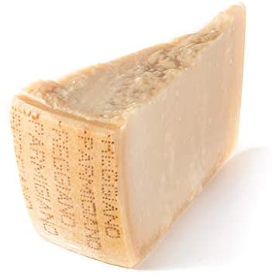
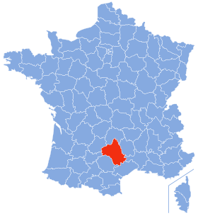

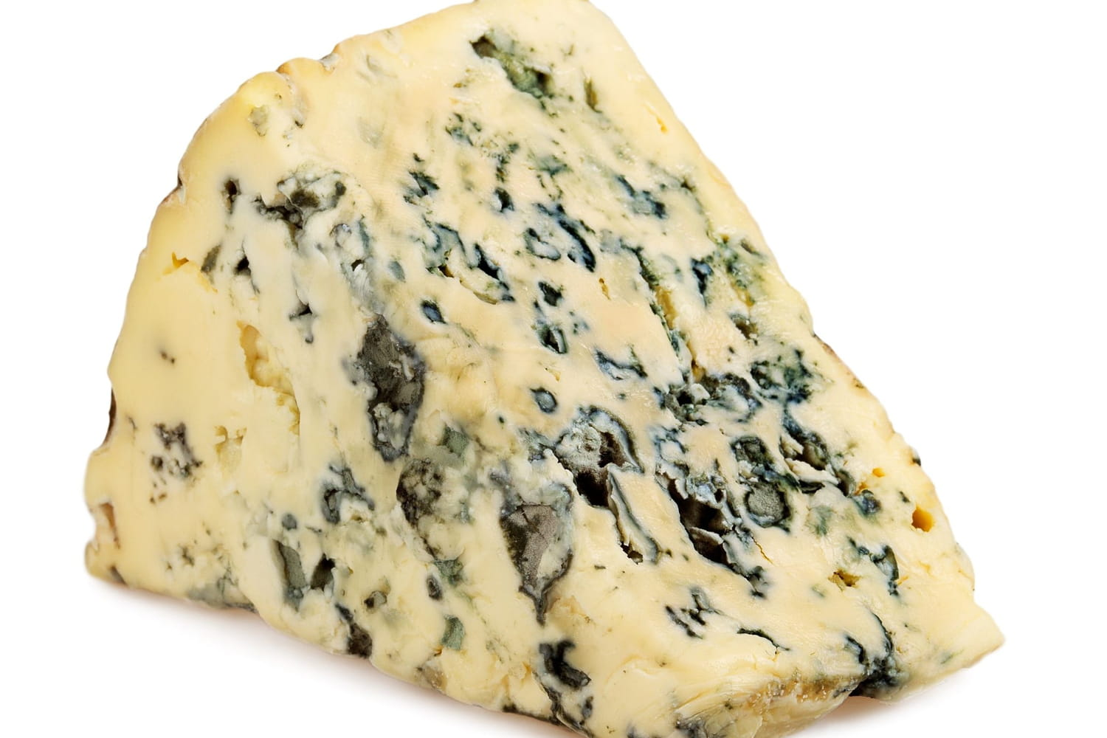
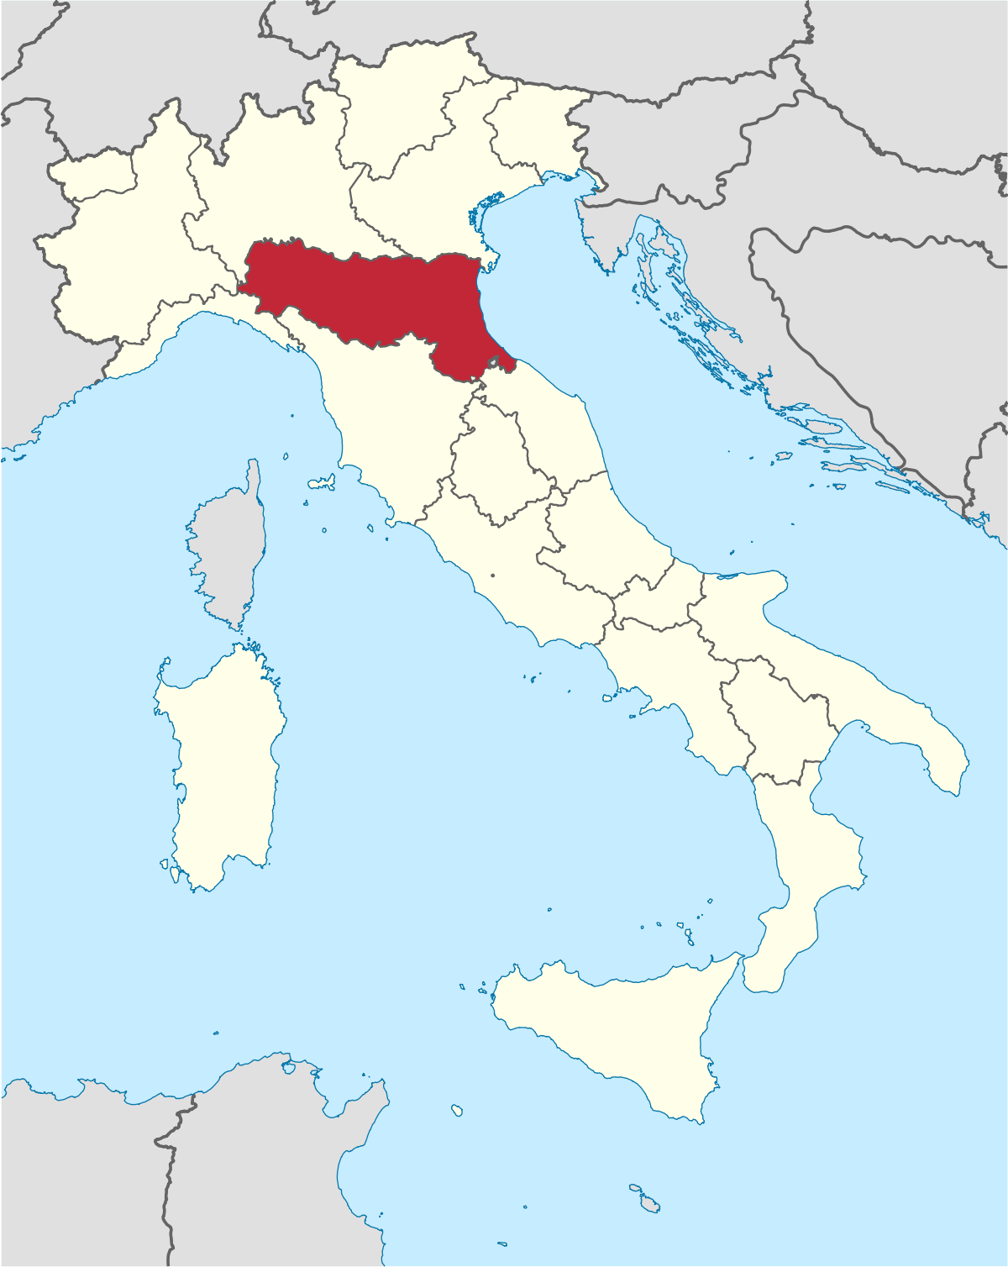
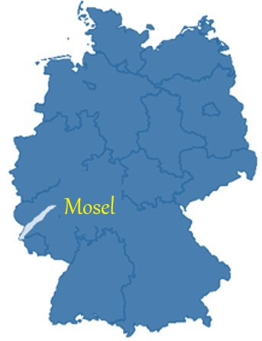
Examples of Foreign GIs Protected as Certification Marks
Italian cheese
The certification mark, as used by persons authorized by Certifier, certifies that the goods originate in the Parma-Reggio region of Italy, specifically the zone comprising the territory of the provinces of Parma, Reggio Emilia, Modena and Mantua on the right bank of the river Po and Bologna on the left bank of the river Reno.
French cheese
The certification is used upon the goods to indicate that the same has been manufactured from sheep’s milk only and has been cured in the natural caves of the community of Roquefort, Department of Aveyron, France.
Mosel
German wine
The mark certifies origin in a geographical region in Germany, and characteristics of quality as most recently defined by the German wine la<.

Slide 9
GI Protection in the United States
A collective mark is another type of trademark. It indicates membership in a collective entity (e.g., union, association or other organization) and distinguishes the geographical origin, quality mode of manufacture, etc. of a product.
A collective mark implies that the members of the collective entity conform to the specified standards set by the parent organization.
Unlike a certification mark, a collective mark is owned by a collective entity.
The collective entity can advertise the mark as well as the products that are sold by its members under the mark.

Slide 10

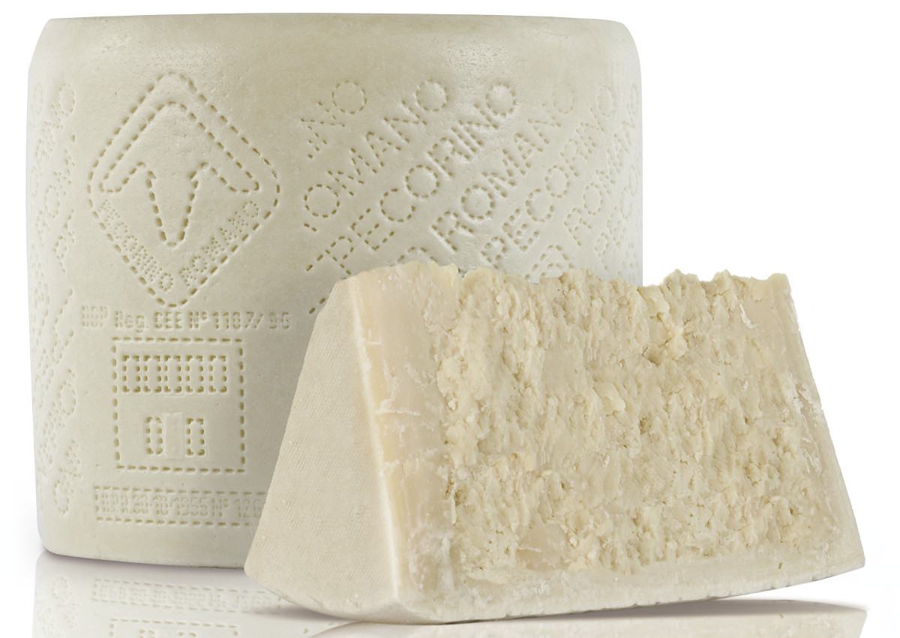
Example of a Foreign GI Protected as a Collective Mark
Pecorino Romano
Italian cheese made from sheep’s milk
# 1341101
Current trademark owner: Consorzio per la Tutela del Formaggio Percorino Romano Unincorporated Association Italy
The mark consists of the Italian words “Pecorino Romano” which means “Roman cheese made from sheep milk” and the stylized representation of a sheep’s head within an inclined square

Slide 11
GI Protection in the United States – Wine, Spirits
In the U.S., GIs for wines, spirits, and malted beverages are protected under Section 205(e) of the Alcohol Beverage Labeling Act of 1988
  The Alcohol and Tobacco Tax and Trade Bureau (TTB) regulates the use of GIs on alcohol beverages and provides for standards of identity and requirements for the labeling and advertising of alcohol beverages (27 CFR Part 4, 5, 7, 13, and 16)
27 CFR § 4.24 – Generic, semi-generic, and non-generic designations of geographic significance
  Generic terms = designations for a class or type of wine. Ex: vermouth and sake.
  Semi-generic terms = designations used to identify a class or type of wine of an origin other than that indicated by its name if (1) the label discloses the place of origin of the wine and (2) the wine conforms to the standard of identity contained in regulations. Ex: New York Chablis, California Champagne.
  Non-generic terms without distinctive designations of specific grape wines: Lake Erie, Napa Valley, Spanish, etc. and with distinctive designations of specific grape wines: Medoc, Chateau Margaux, Pommard, etc.
27 CFR § 4.91 – List of approved names which can be used to designate American wines.

Slide 12
GI Protection in the European Union
The European GI system is more protective than the U.S. trademark system
  The Lisbon Agreement for the Protection of Appellations of Origin and their International Registration (as amended in September 1979)
    Defines and protects Appellations of Origin (AOC)
    Establishes an International Register for Protected Appellations of Origin
  The Geneva Act of the Lisbon Agreement on Appellations of Origin and Geographical Indications (as adopted in May 2015)
    The Geneva Act distinguishes between Appellations of Origin (AOC) and Geographical Indications (GI) and provides that registered AOCs and GIs cannot become generic terms in other member countries.
The EU protects GIs through specific regulations:
  Wines (Regulation 1308/2013)
  Aromatized wines (Regulation 251/2014)
  Spirit drinks (Regulation 2019/787)
  Agricultural products and foodstuffs (Regulation 1151/2012)

Slide 13


GI Protection in the European Union
The existing EU GI system distinguishes GIs into two categories:
Protected Designation of Origin (PDO)
  Applies to agricultural products and foodstuff
  Identifies a product originating from a specific geographical area whose quality or characteristic is essentially or exclusively due to a particular geographic environment and its natural and human factors
  Every step of the production, processing, and preparation process must take place in the same geographical area.
Protected Geographical Indication (PGI)
  Applies to agricultural products and foodstuff
  Identifies a product originating from a specific geographical area whose quality, reputation or other characteristic is essentially attributable to the geographical origin of the product.
  At least one of the steps of production, processing, or preparation must take place in the place of origin.

Slide 14
Differences between EU GIs and U.S. Trademarks
A good originating from a specific place vs. originating from a particular company
A private right vs. a collective right
A trademark belongs to the company that created the trademark and can be licensed to anyone. A GI belongs to any producer located in the region identified by the GI

Slide 15
Bilateral Trade Agreements
The EU has concluded several stand-alone or free trade agreements that contain significant level of protection for geographical indications, including with countries of the Association of Southeast Asian Nations (ASEAN), Central America countries, Canada, and Mexico, among others.
  The goal is to establish a list of GIs identifying agricultural products to be protected directly and permanently by the trading partner
Agreement between the United States of America and the European Community on Trade in Wine (signed on March 10, 2006)
  Allows U.S. wine producers to continue using 16 semi-generic names on labels that were approved prior to the entry into force of the bilateral agreement: Burgundy, Chablis, Champagne, Chianti, Claret, Haut Sauterne, Hock, Madeira, Malaga, Marsala, Moselle, Port, Rhine, Sauterne, Sherry, and Tokay.
  Allows U.S. wine producers selling their wine in the EU to use the following traditional labeling terms: chateau, classic, clos, cream, crusted/crusting, fine, late bottled vintage, noble, ruby, superior, sur lie, tawny, vintage and vintage character.

Slide 16
Economical Value of EU GIs
“Citizens and consumers in the Union increasingly demand quality as well as traditional products. They are also concerned to maintain the diversity of the agricultural production in the Union. This generates a demand for agricultural products or foodstuffs with identifiable specific characteristics, in particular those linked to their geographical origin” – Reg. EU No. 1151/2012 on quality schemes for agricultural products and foodstuffs
EU GIs benefit:
Producers, because GIs allow for higher prices on the market – on average x2 the price of a conventional product – and a better division of the added value along the food chain
Consumers, because GIs provide a guarantee on the origin, quality and authenticity of the product. GIs are signs of commercial trust
Society, because GIs protection help secure jobs and maintain economic activities in rural – sometimes remote – areas; encourage the preservation of biodiversity and sustainable agriculture, local and traditional knowledge; and promote tourism.

Slide 17
Economical Value of EU GIs
“The total sales value of GIs was estimated at approximately EUR 75 billion in 2017. More than half (51.1%) of this value was accounted for wines; 35.4% was covered by agricultural product and foodstuffs; spirit drinks represented 13.4%; and aromatized wine products made up 0.1%.”
  The global increase of the value is estimated at 37%, which represented an amount of EUR 20.2 billion
Exports of GI products to non-EU countries accounted for EUR 16.95 billion
  Came mainly from France (Champagne, Cognac), Italy (Grana Padano, Parmigiano-Reggiano, Prosecco) and the United Kingdom (Scotch Whisky)
Source: Study on economic value of EU quality schemes, geographical indications (GIs) and traditional specialties guaranteed (TSGs) Final Report, European Commission (February 2021)

Slide 18
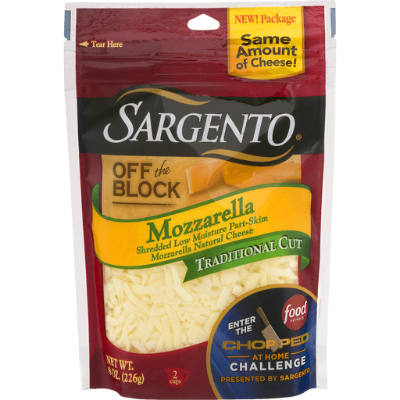
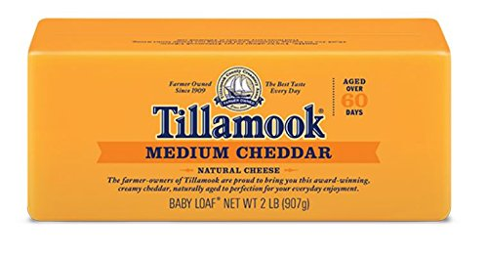
Impacts of EU GIs on U.S. Agricultural Trade
The real issue has to do with the scope of protection granted to GIs and Europe’s agenda to register names that have already entered the public domain and are considered to be generic terms according to the U.S.
Some common names have been used for generations in the U.S. and become part of brand names.
  If a common name becomes a protected GI, it would be economically
  harmful to U.S. producers.

Slide 19
Impacts of subsequent GI restrictions on common cheese names in the U.S.
“… total U.S. milk equivalent consumption would fall between 56 billion and 136 billion pounds."
“Farm-gate margins would remain significantly below breakeven levels … forcing greater liquidation of the U.S. dairy herd. The loss in herd size would range between 460,000 to 740,000 head due to the implications of GI restrictions on common cheese terms in the U.S.”
“… farm revenue losses would continue to mount with the delayed impacts, reaching a cumulative $71.8 billion in lost revenue …”
Source: Assessing the Potential Impact of Geographical Indications for Common Cheeses on the US Dairy Sector, Prepared for the U.S. Dairy Export Council (November 2018)

Slide 20
Gruyere Cheese: Generic or Not?
September 17, 2015 – Interprofession du Gruyère and Syndicat Interprofessionel du Gruyère filed an application under 15 U.S.C. § 1054 to register the term “gruyère” as a certification mark for cheese. Serial No. 86759759.
August 5, 2020 – The U.S. PTO Trademark Trial and Appeal Board concluded that “purchasers and consumers of cheese understand the term ‘gruyere’ as a designation that primarily refers to a category within the genus of cheese that can come from anywhere.” Proceeding No. 91232427.
October 6, 2020 - Interprofession du Gruyère and Syndicat Interprofessionel du Gruyère appealed the USPTO decision before the U.S. District Court for the Eastern District of Virginia. Interprofession du gruyère, et al. v. International Dairy Foods Opposition, et al., No. 1:20-cv-1174.
December 15, 2021 – The U.S. District Court dismissed Plaintiffs’ claims.
January 7, 2022 – Appeal filed with the U.S. Court of Appeals for the Fourth Circuit, No. 22-1041

Slide 21
EU GI Protection in Preferential Trade Agreements
The U.S. is concerned with the EU trying to extend recognition of its GI protection system in other countries through bilateral agreements and repossess the use of common names, with the likely result that future sales of U.S. exported products using common names would be restricted in other countries. Ex: the EU-Canada Comprehensive Economic and Trade Agreement (CETA)
  The U.S. argued that such agreement between the EU and Canada would jeopardize the U.S. national interest and would affect trade relationships between Canada and the U.S., both of which are signatories to the North American Free Trade Agreement (NAFTA).
  The EU and Canada signed the agreement on October 30, 2016; Canada recognized 143 GIs and agreed to their protection, including product names that are considered generic terms in the U.S., such as asiago, feta, fontina and gorgonzola
  USDA reported that, under the agreement, “Canadian GI coverage expands beyond existing protections for wine and spirits to a broad range of agricultural products including cheeses, meats, and olives. Such provisions can limit U.S. market access in Canada for a number of these products.” Source: USDA Foreign Agricultural Service (FAS) Report, United States-Canada Agricultural Trade Implications of Canada-EU CETA (2017)

Slide 22
USMCA – Heightened Protection for Generic Terms
The U.S.-Mexico-Canada Agreement (USMCA) Article 20.29-35
Art. 20.29 recognizes that GIs may be protected through a trademark system, specifically crafted regulations (sui generis system) or other legal means.
Art. 20.30 outlines how each party should process applications for GIs and spells out administrative requirements that parties must follow when applying for protection or petitioning for recognition.
Art. 20.31 provides that if a party protects or recognizes GIs through the procedures outlined in Art. 20.30, then the party must provide interested parties with the legal means to oppose or refuse GI applications. It also provides for three grounds of opposition:
  Likeliness to cause confusion with a pre-existing good faith application for a trademark that has already been filed
  Likeliness to cause confusion with a pre-existing trademark
  The term for the good is common language for the good in the territory of the party.
A party is not required to apply Art. 20.31 to GIs identifying wines and spirits.

Slide 23
USMCA – Heightened Protection for Generic Terms
Art. 20.32 sets out guidelines for determining whether a term is customary in the common language and allows the party’s authorities to consider how consumers understand the term in the territory of that party:
  Whether competent sources, such as dictionaries, newspapers, and relevant websites, commonly refer to the good by the term;
  How the good referenced by the term is marketed and used in trade;
  Whether the term for the good is used in relevant international standards recognized by the parties, ex: Codex Alimentarius;
  Whether the good referenced by the term is imported in significant quantities.
Art. 20.35 specifies the requirements for administrative procedures when a party to the USMCA recognizes or protects a GI pursuant to an international agreements.
  The administrative procedures in international agreements must be similar to the ones listed in Art. 20.30 and Art. 20.31-1 and 2.
  Art. 20.35 does not apply to GIs that have already been granted protection in international agreements ratified prior to the date of ratification of this agreement.

Slide 24
USMCA – Heightened Protection for Generic Terms
“In recognition of their shared commitment to certainty and transparency in trade, the Parties recognize that the following terms are terms used in connection with cheeses from U.S. producers currently being marketed in Mexico. Mexico confirms that Mexican cheese producers also use these terms. Mexico confirms that market access of U.S. products in Mexico is not restricted due to the mere use of these individual terms.”
Blue Colby Emmentaler Mozzarella Swiss
Blue vein Cottage Emmenthal Pecorino Tomme
Brie Coulommiers Gouda Pepper Jack Tome
Burrata Cream Grana Provolone Toma
Camembert Danbo Havarti Ricotta Tilsiter
Cheddar Edam Mascarpone Saint-Paulin
Chevre Emmental Monterey Jack Samsø
Side letter to the USMCA between the U.S. and Mexico discussing the use of cheese names

Slide 25
Special 301 Report
Under Section 182 of the Trade Act of 1974, as amended, the Office of the United States Trade Representative (USTR) is required to conduct an annual review of the state of intellectual property (IP) protection and enforcement in U.S. trading partners.
The purpose of Special 301 Report is to identify U.S. trading partners that “deny adequate and effective IP protections of fair and equitable market access to U.S. persons who rely on IP protection.” Special 301 Report contains a section on geographical indications.
“The United States is working intensively through bilateral and multilateral channels to advance U.S. market access interests in foreign markets and to ensure that geographical indications (GI)-related trade initiatives of the European Union (EU), its Member States, like-minded countries, and international organization do not undercut such market access … The EU GI agenda remains highly concerning because it significantly undermines protection of trademarks held by U.S. producers and imposes barriers on market access for U.S.-made goods that rely on the use of common names, such as parmesan or feta.”
2022 Special 301 Report

Slide 26
Thank you!
Chloe J. Marie
Research Specialist
Center for Agricultural and Shale Law
Penn State Law
329 Innovation Boulevard, Suite 118
University Park, PA 16802
(814) 863-3396
cjm445@psu.edu

Slide 27


